Slide 1
DLP: CV module
Object Detection
Kaushik Mitra
Electrical Engineering
IIT Madras

Slide 2
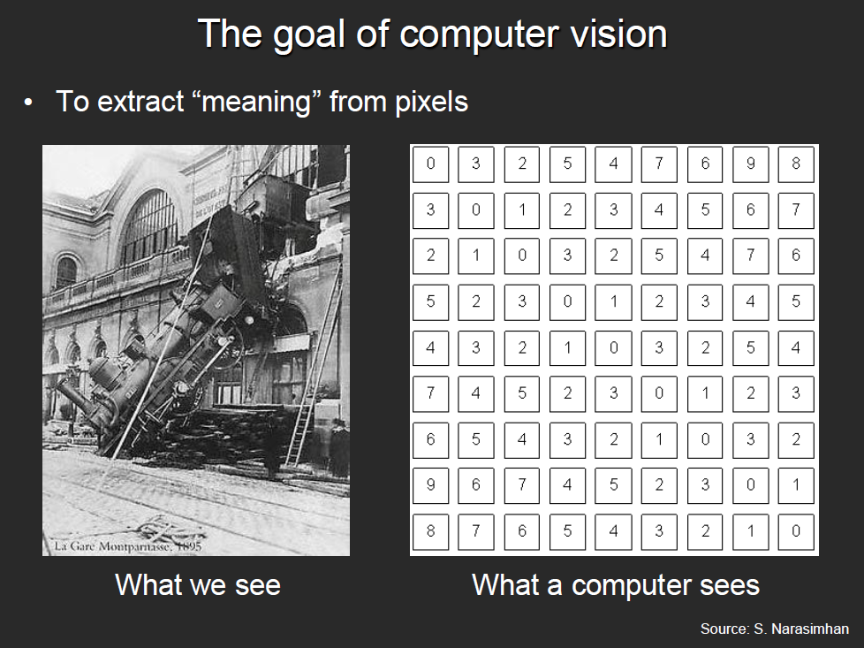
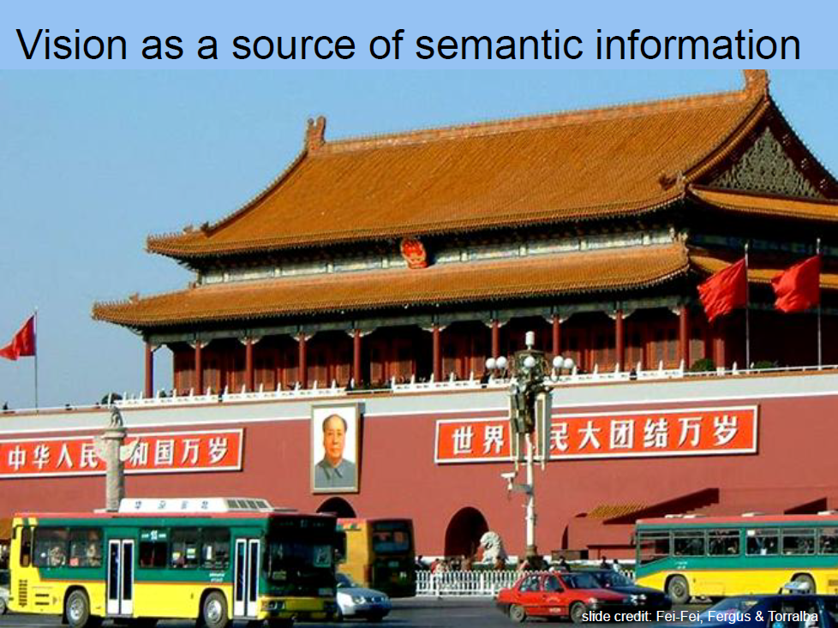
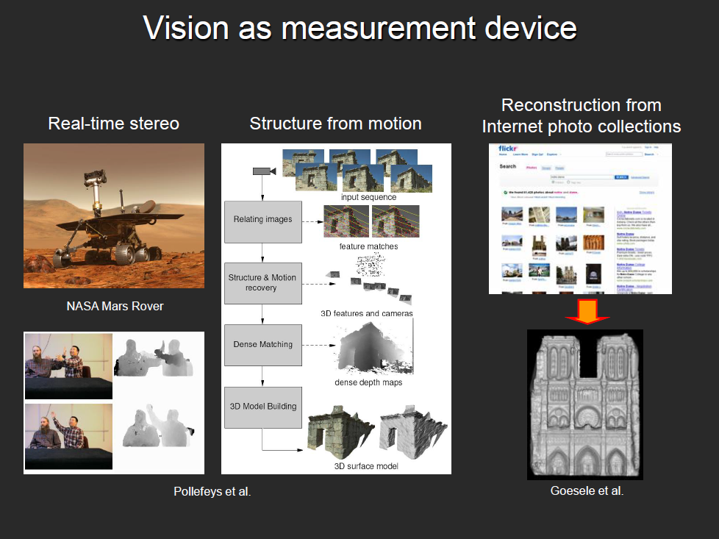
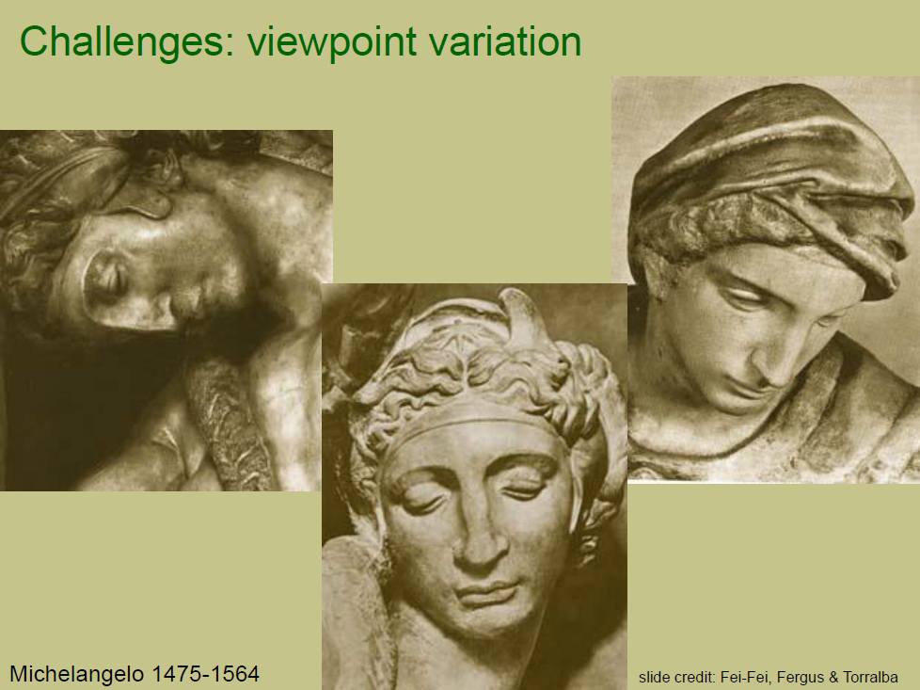
What we covered last time
Our focus in this course
Object Recognition
Object Detection
Depth from single image
Image pre-processing
Advantage of CNN over MLP
Local connectivity
Parameter sharing
Efficient runtime and storage
Different layers in CNN
Convolutional layer
ReLU
Pooling
Fully connected layer

Slide 3
Outline
Definition
Region-based convnets (R-CNN)
Fast RCNN
Faster RCNN
YOLO

Slide 4
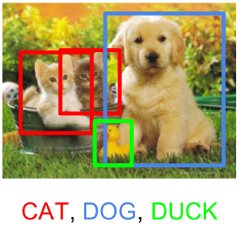
Object Detection
Another important task in computer vision
The task of assigning a
label and a bounding box
to all objects in the image
Slide credit: Amaia Salvador @slideshare

Slide 5
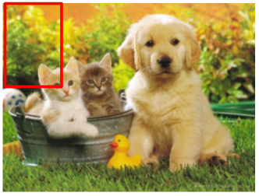
Object Detection
We can do this as image classification
Labels = [cat, dog, duck]
Cat? No
Dog? No
Duck? No
Slide credit: Amaia Salvador @slideshare

Slide 6
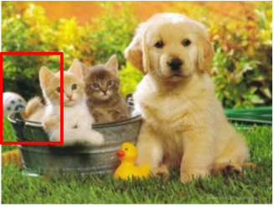
Object Detection
We can do this as image classification
Labels = [cat, dog, duck]
Cat? No
Dog? No
Duck? No
Slide credit: Amaia Salvador @slideshare

Slide 7
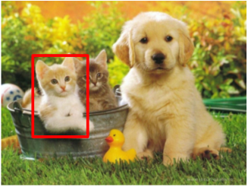
Object Detection
We can do this as image classification
Labels = [cat, dog, duck]
Cat? Yes
Dog? No
Duck? No
Slide credit: Amaia Salvador @slideshare

Slide 8
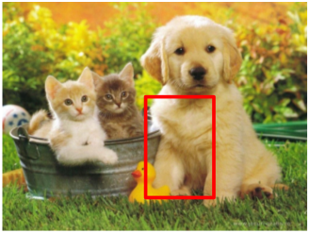
Object Detection
We can do this as image classification
Labels = [cat, dog, duck]
Cat? No
Dog? No
Duck? No
Slide credit: Amaia Salvador @slideshare

Slide 9
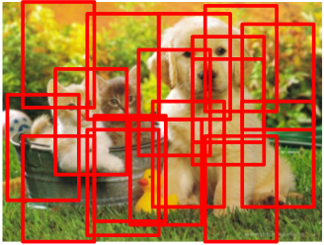
Object Detection
We can do this as image classification
Problem: Too many positions & scales to test
Solution: If your classifier is fast enough, go for it
Slide credit: Amaia Salvador @slideshare

Slide 10
Outline
Definition
Region-based Convnet (R-CNN)
Fast RCNN
Faster RCNN
YOLO

Slide 11
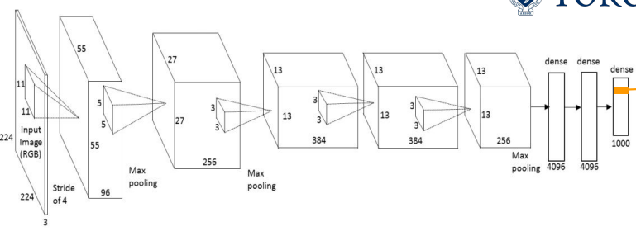
Object Detection with ConvNets
We can do this with a image classification network
Convnets are computationally demanding. We can’t test all positions & scales !
Solution: Look at a tiny subset of positions. Choose them wisely :)
Slide credit: Amaia Salvador @slideshare

Slide 12
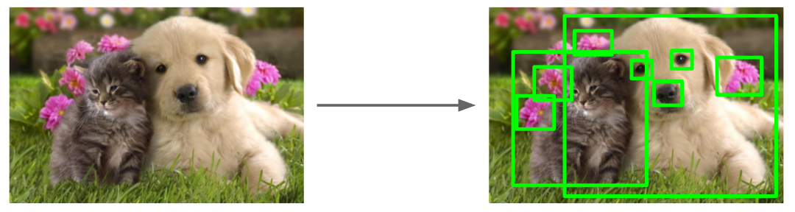
Object Detection via Region Proposals
Find “blobs” that are likely to contain objects
“Class-agnostic” proposals
Slide credit: Amaia Salvador @slideshare

Slide 13
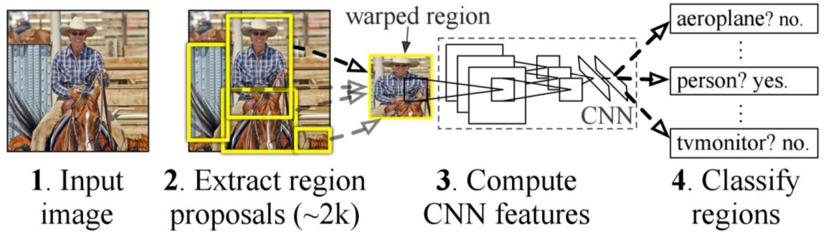
Object Detection with ConvNets: RCNN
Girshick et al. Rich feature hierarchies for accurate object detection and semantic segmentation. CVPR 2014

Slide 14
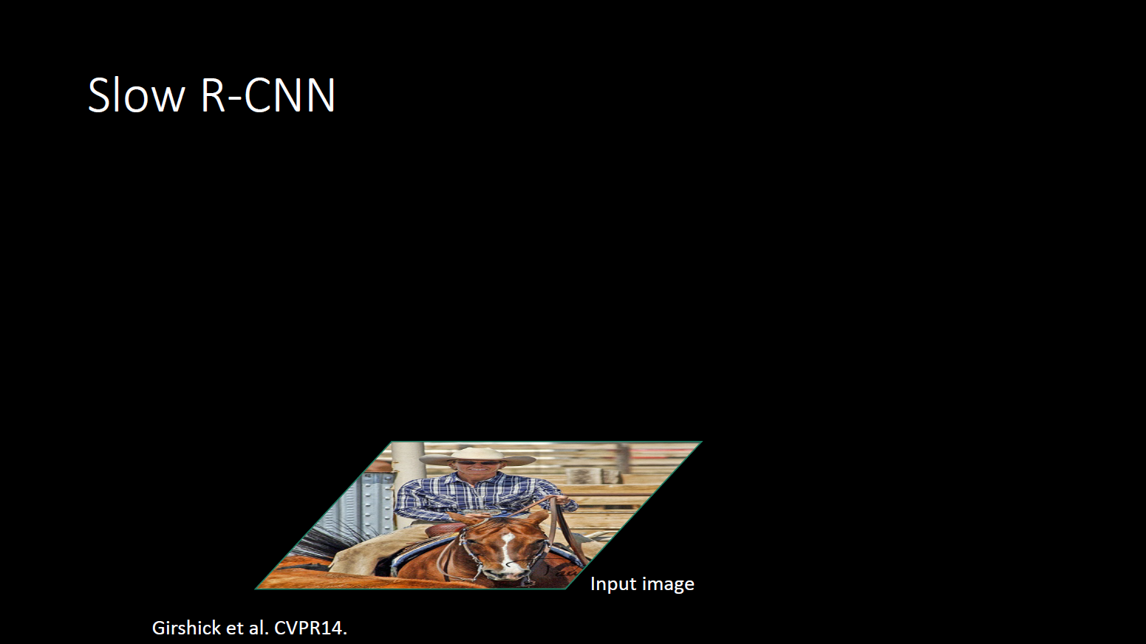
(aka RCNN)

Slide 15
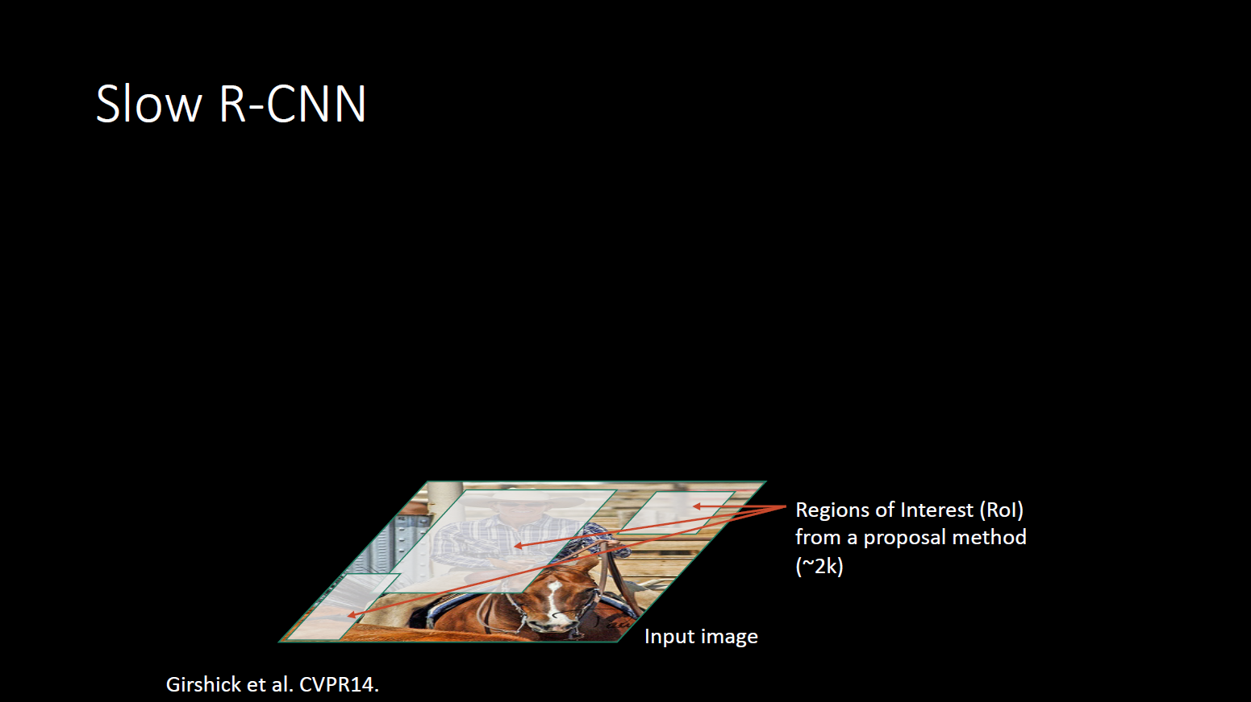

Slide 16
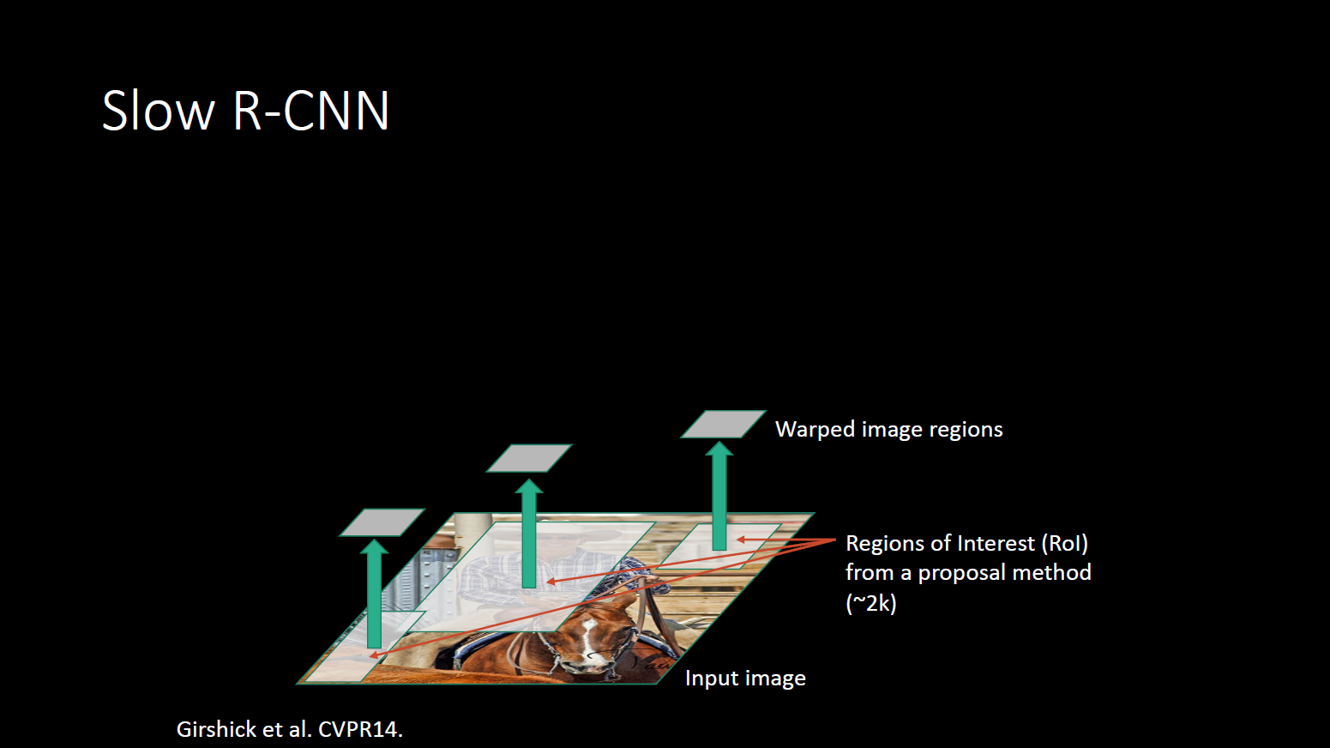

Slide 17
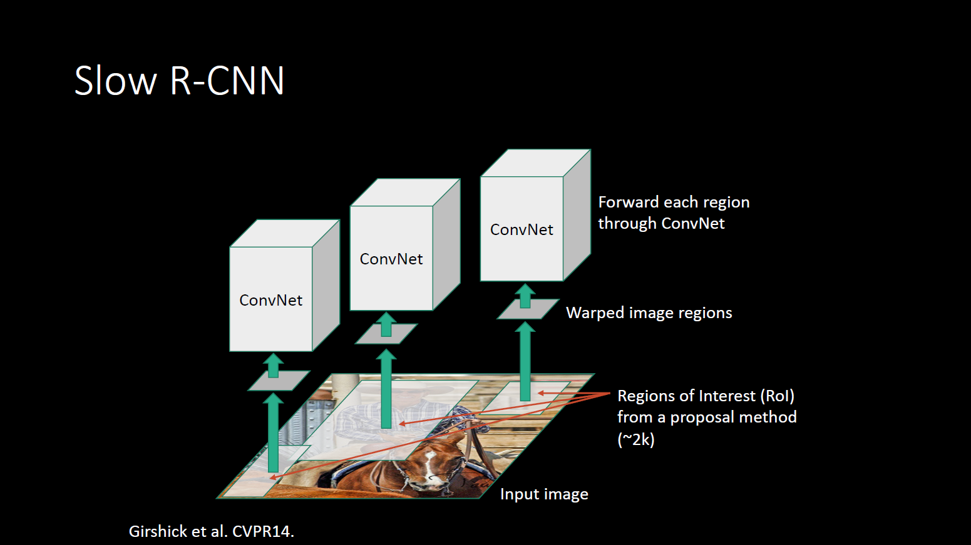

Slide 18
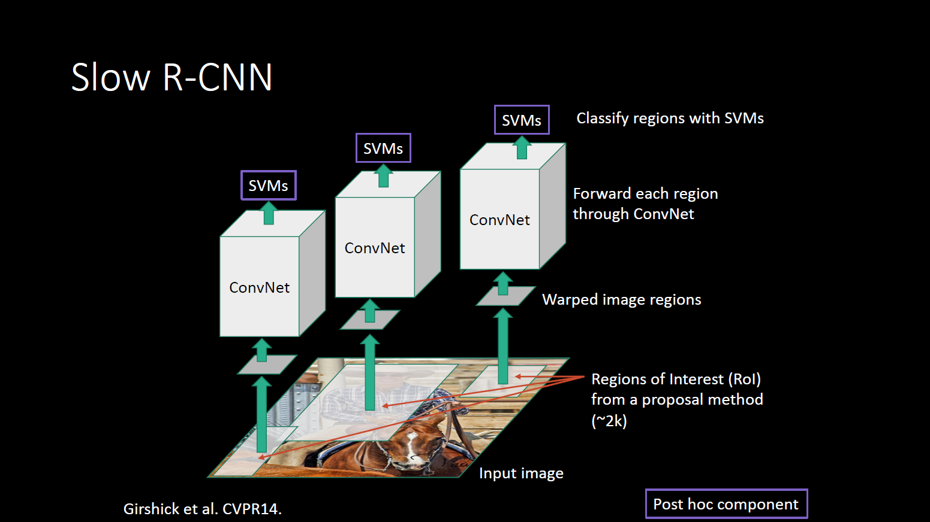

Slide 19
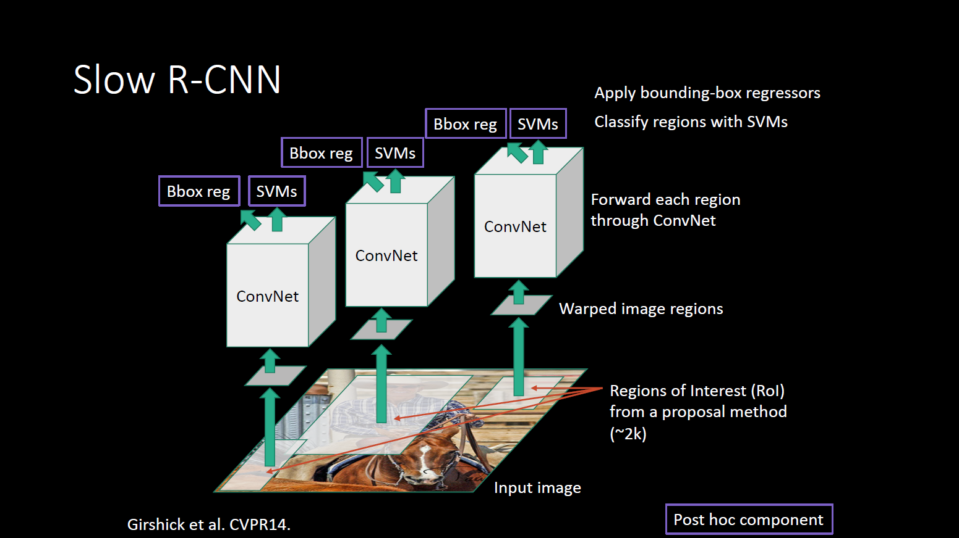

Slide 20
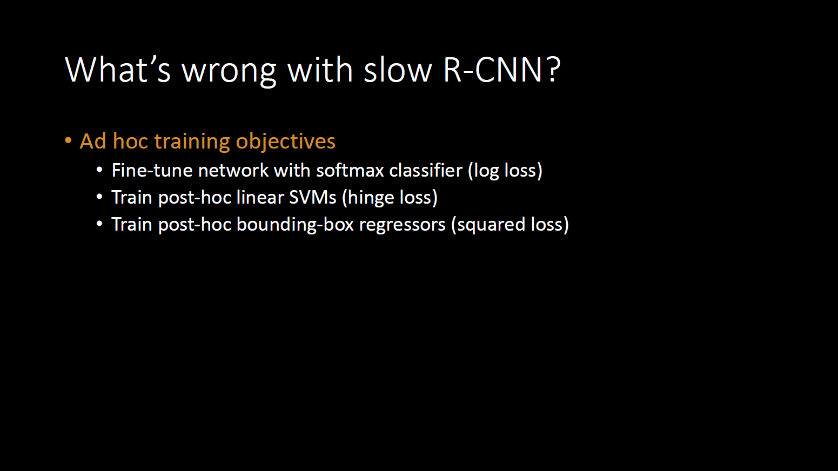

Slide 21
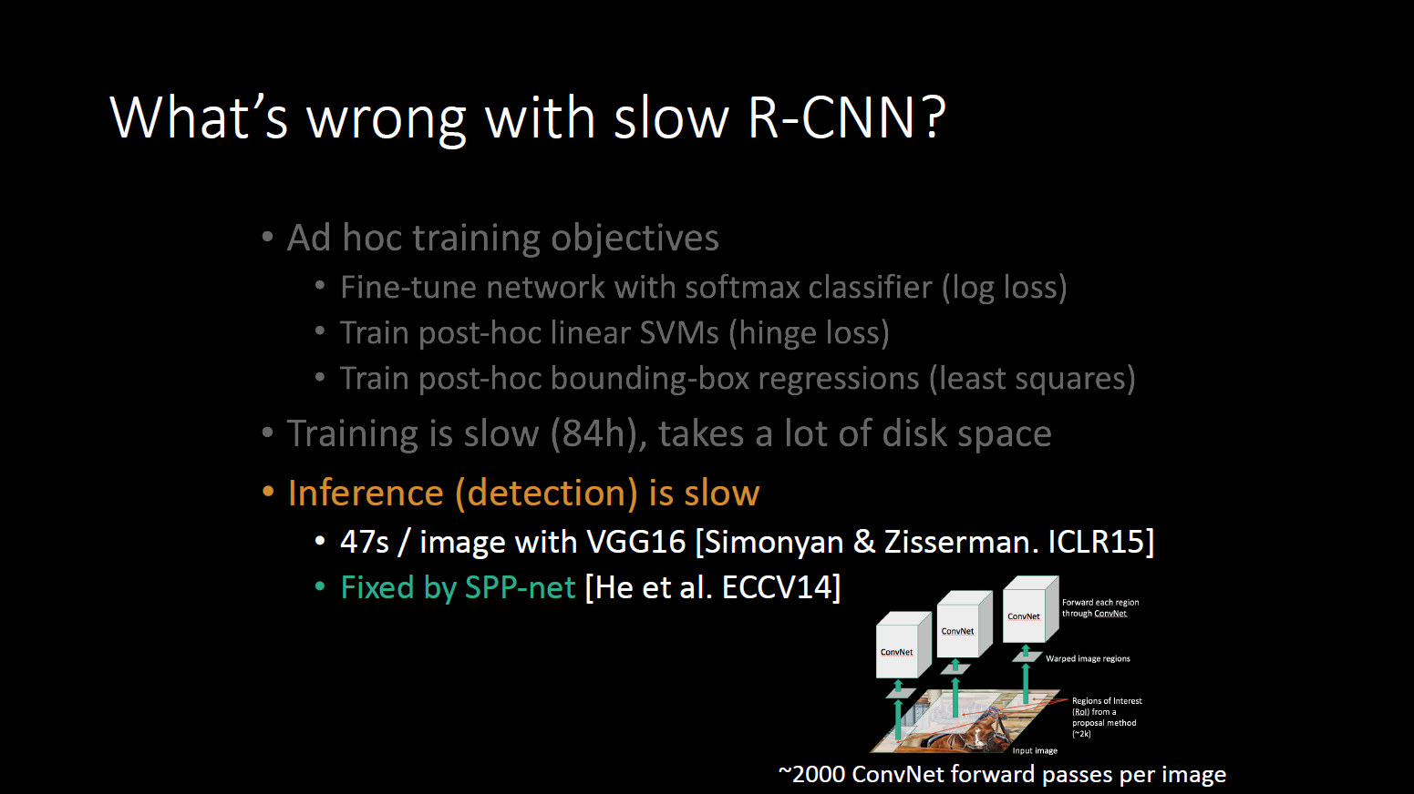

Slide 22
Outline
Definition
Region-based convnets (R-CNN)
Fast RCNN
Faster RCNN
YOLO

Slide 23
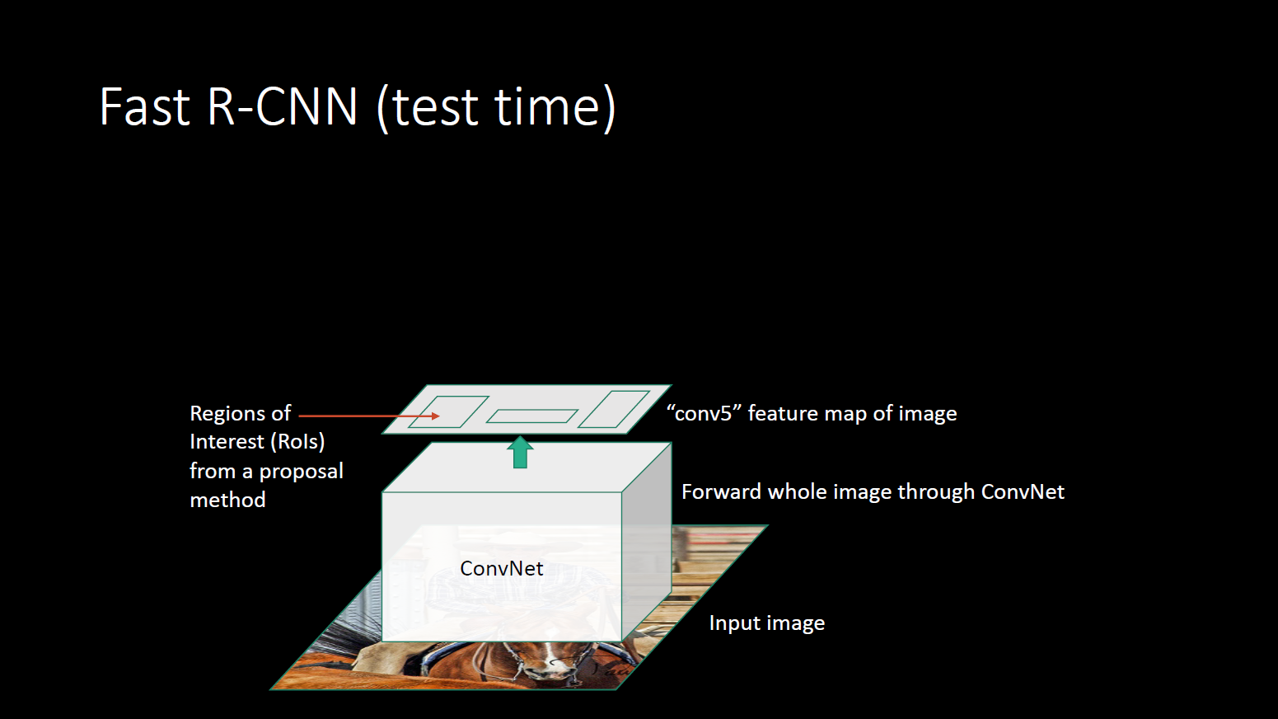

Slide 24


Slide 25
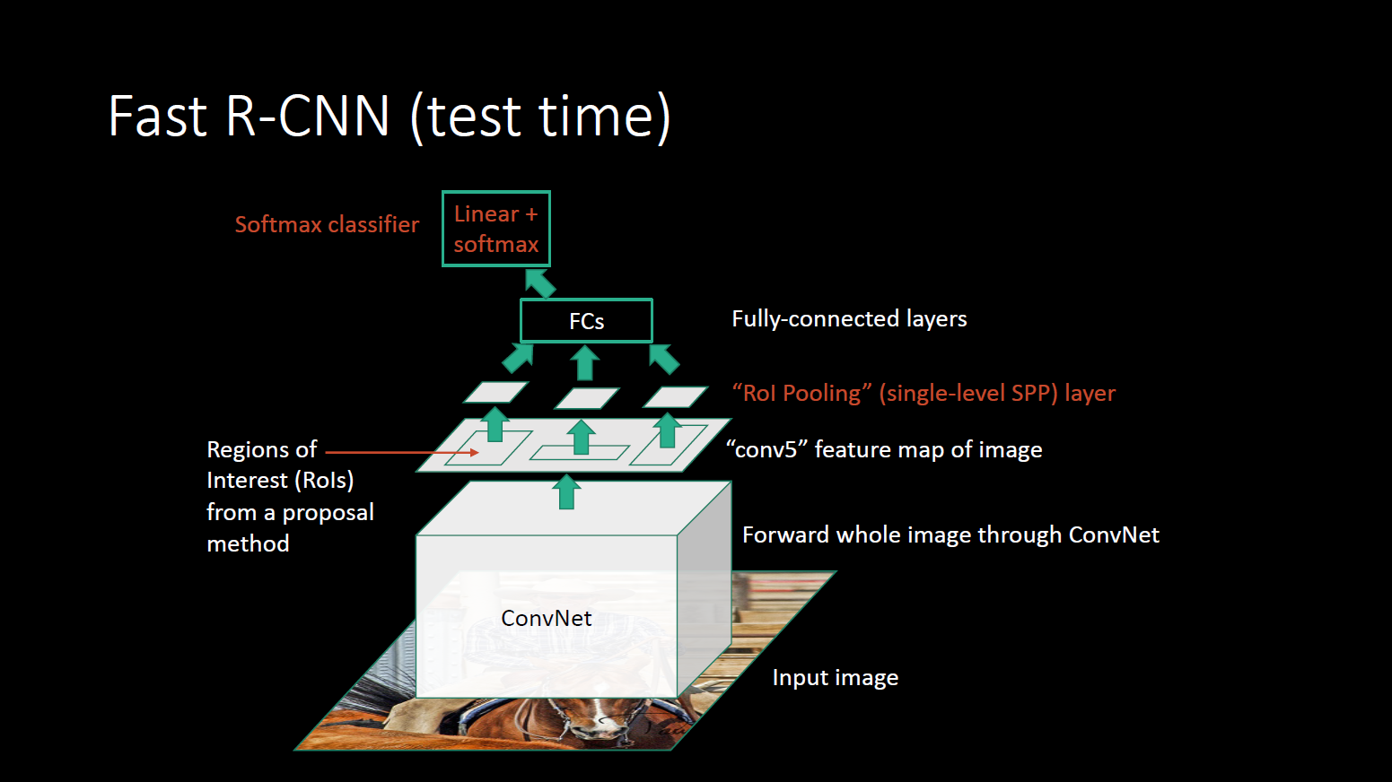

Slide 26


Slide 27
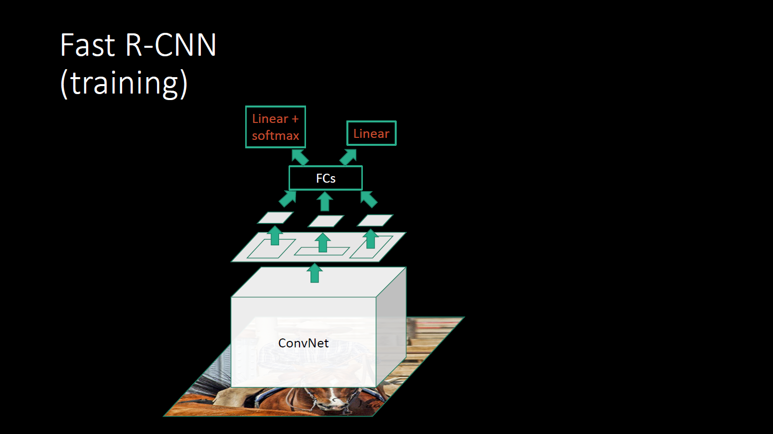

Slide 28


Slide 29
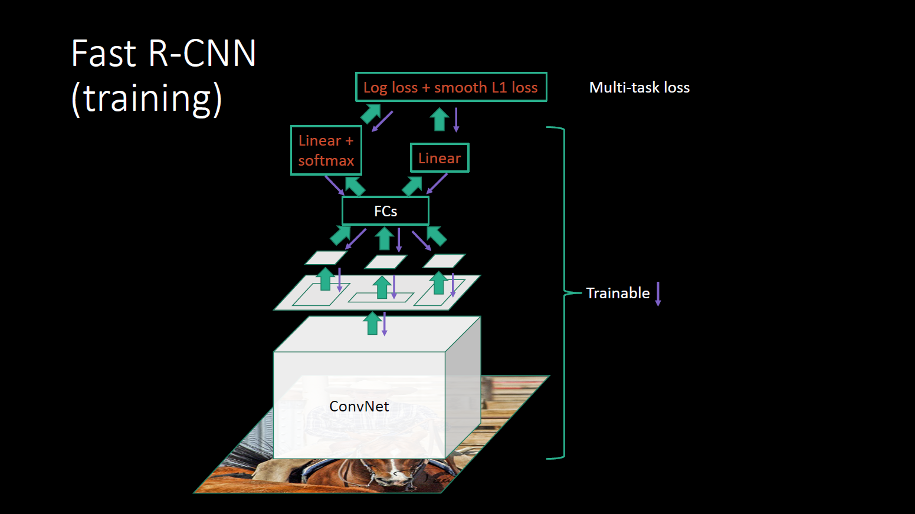

Slide 30
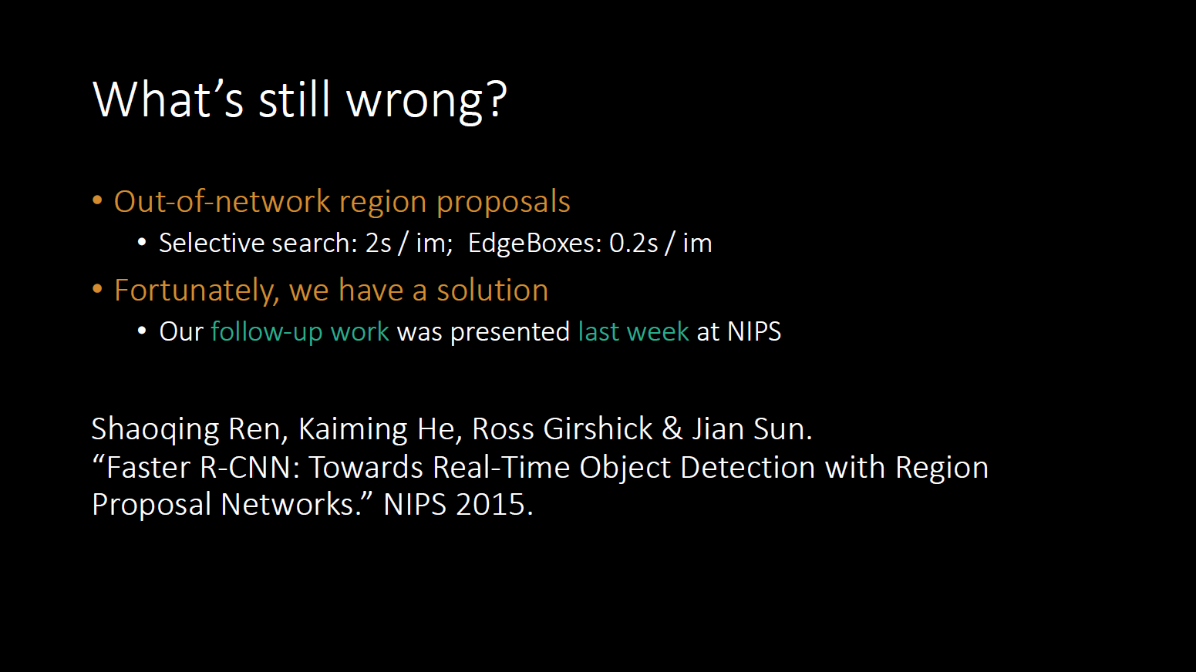

Slide 31
Outline
Definition
Region-based convnets (R-CNN)
Fast RCNN
Faster RCNN
YOLO

Slide 32
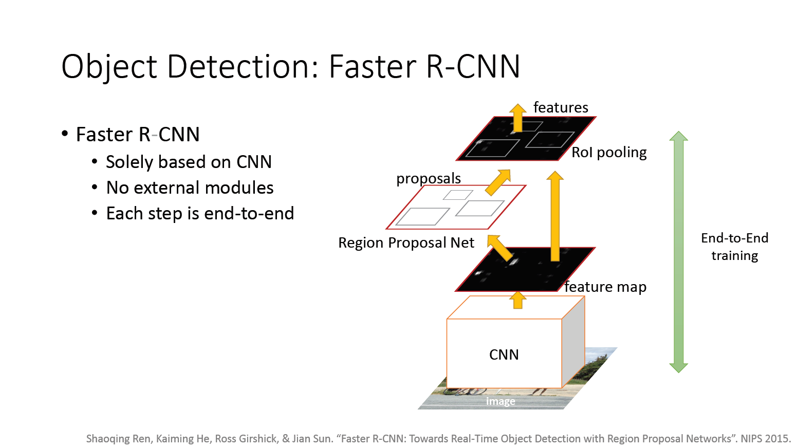

Slide 33
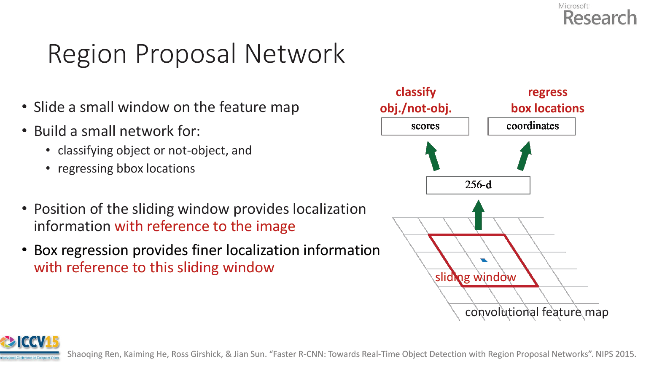

Slide 34
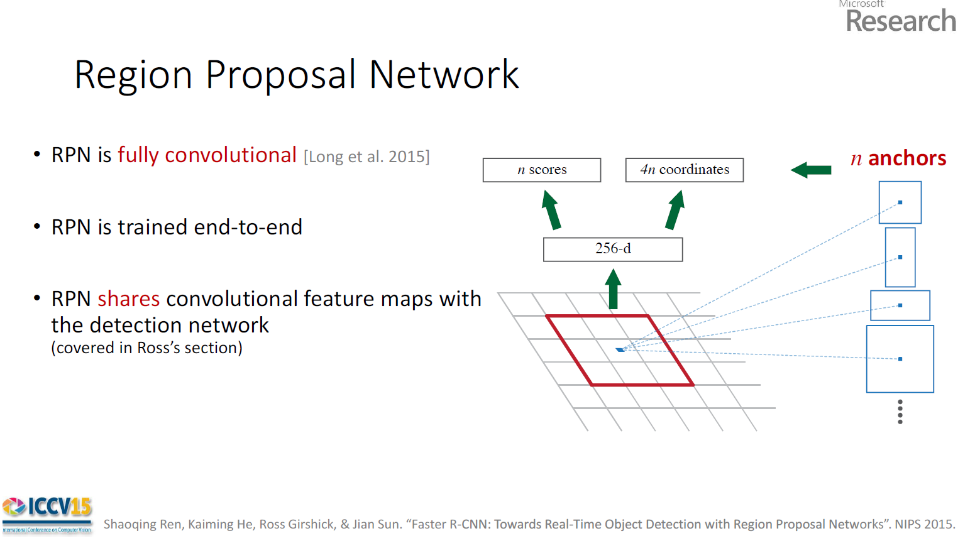

Slide 35
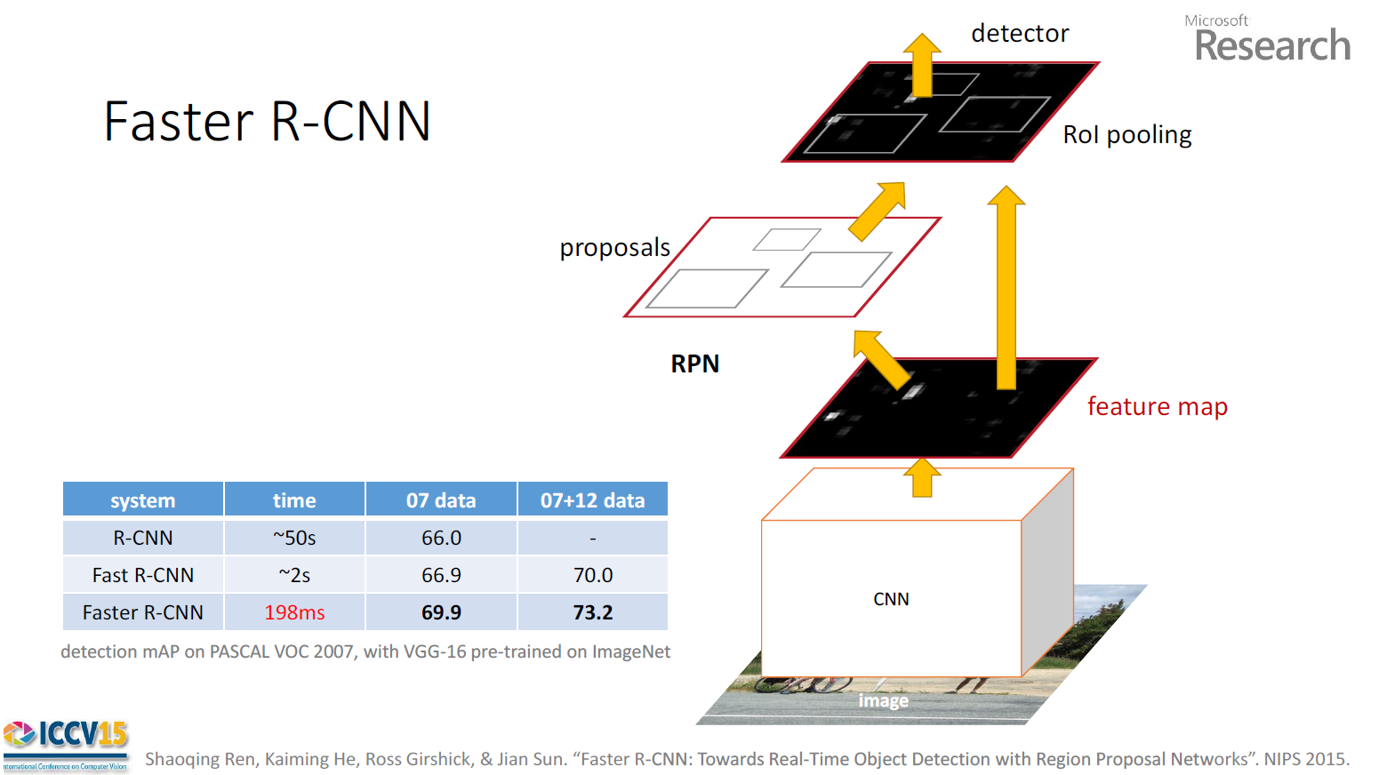

Slide 36
Outline
Definition
Region-based convnets (R-CNN)
Fast RCNN
Faster RCNN
YOLO (You Only Look Once)

Slide 37
Advantage of YOLO over R-CNN versions
Previous Approaches
A separate model for generating bounding boxes and for classification (more complicated model pipeline)
Need to run classification many times (expensive computation)
Looks at limited part of the image (lacks contextual information for detection)
YOLO
A single neural network for localization and for classification (less complicated pipeline)
Need to inference only once (efficient computation)
Looks at the entire image each time leading to less false positives (has contextual information for detection)

Slide 38
Overview of You Only Look Once (YOLO)
First, image is split into a SxS cells.
For each cell, generate B bounding boxes
For each bounding box, there are 5 predictions: x, y, w, h, confidence
For each cell, we need to also do object classification.

Slide 39
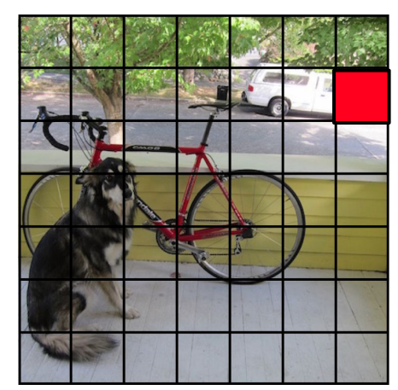
The image is divided into a 7 x 7 grid. For example, the red box is a cell in the grid.

Slide 40
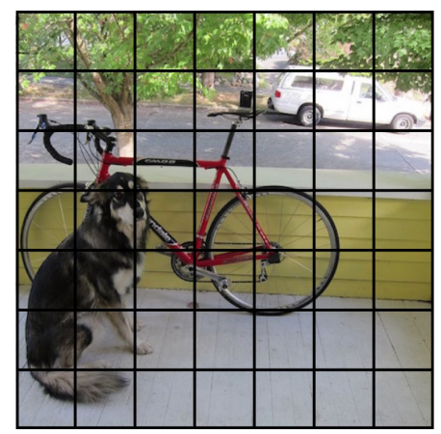
For each cell, generate B bounding boxes. For example B=2.
For each bounding box, YOLO outputs x,y,w,h, and confidence of a presence of an object P(object).

Slide 41
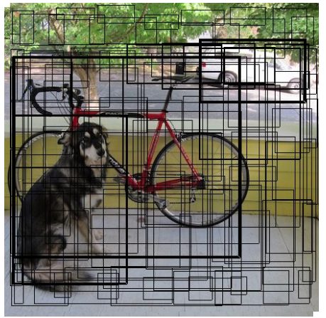

Slide 42
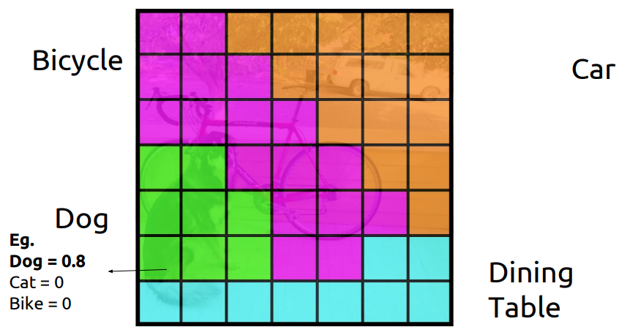
Each cell also predicts a class probability conditioned on object being present. For example P(Car | Object)

Slide 43
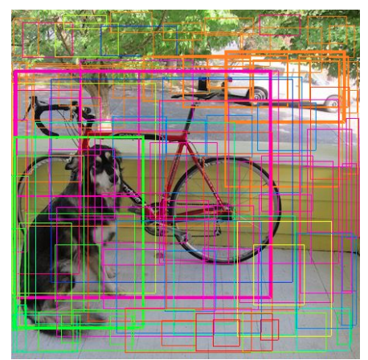
P(class|Object) * P(Object) =P(class)

Slide 44
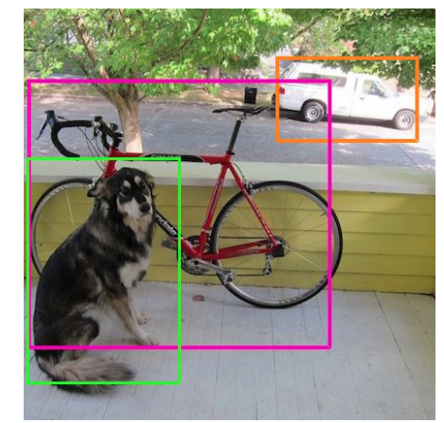
Further Thresholding operation and NMS

Slide 45
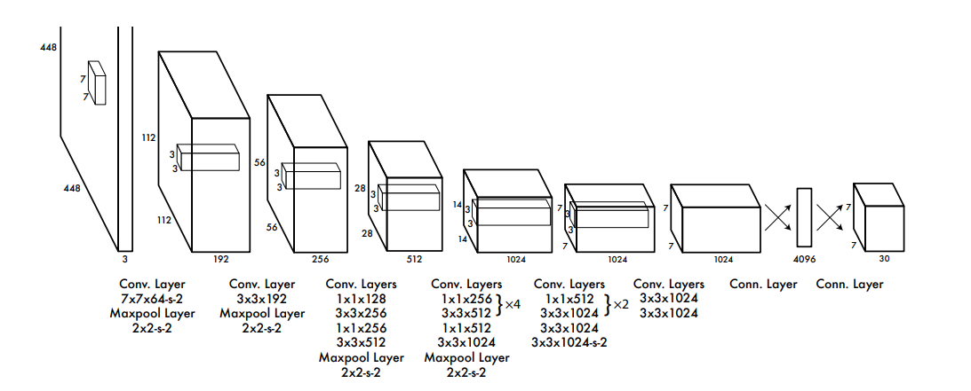
Yolo Architecture
Input image size is 448x448x3
24 convolution layers
Default parameters: S = 7, B = 2, C = 20
Output is S*S*(5B+C) = 7*7*(5*2+20) = 7*7*30

Slide 46
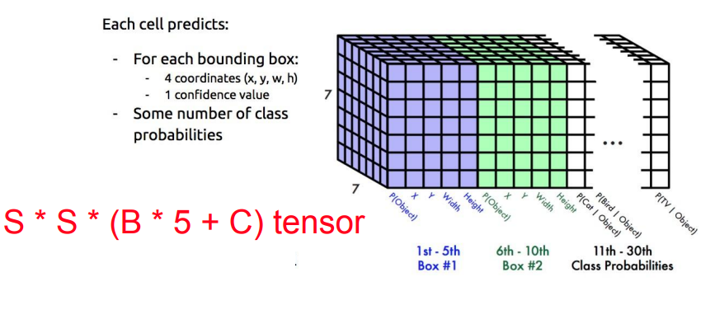

Slide 47
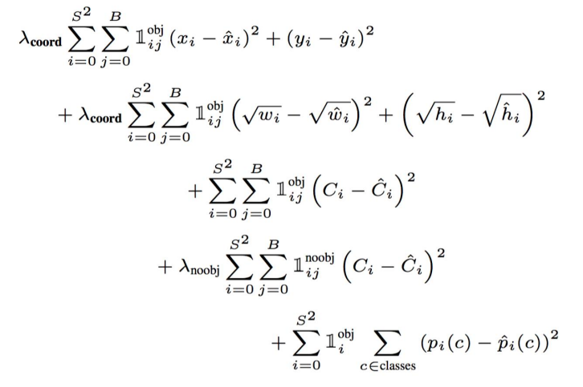
Loss Function in YOLO Model

Slide 48
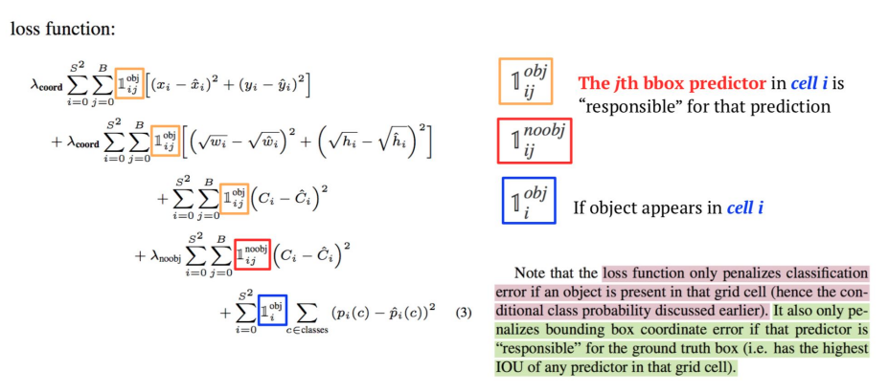

Slide 49
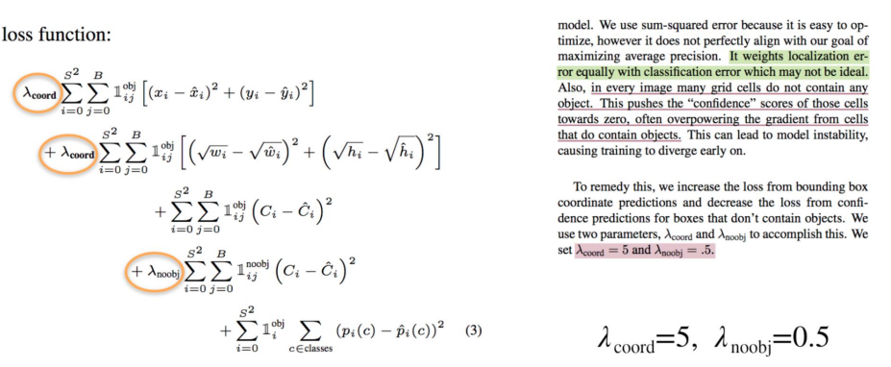

Slide 50
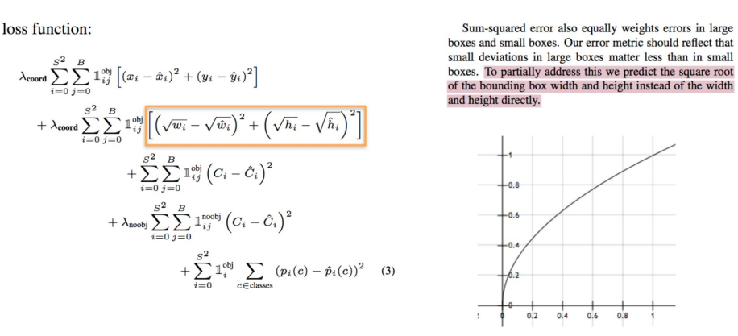

Slide 51
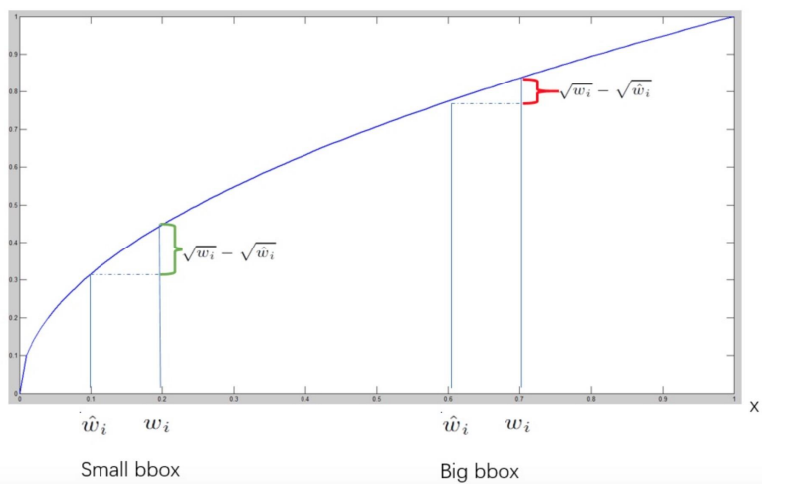
Small boxes should be predicted with more accuracy

Slide 52
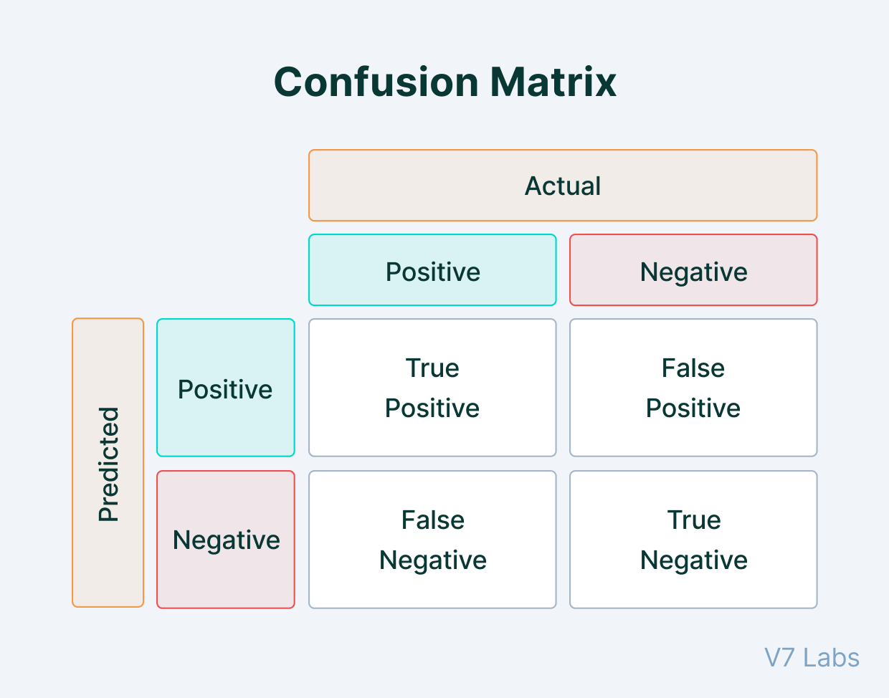
Object detection metric: Mean Average Precision (mAP)
mAP is measure of how well the detector is able to localize and classify the objects in a image. It is based on the concepts of Confusion Matrix, Intersection Over Union (IoU), Precision and Recall
To create a confusion matrix, we need four attributes:
True Positives (TP): The model predicted a label and matches correctly as per ground truth.
True Negatives (TN): The model does not predict the label and is not a part of the ground truth.
False Positives (FP): The model predicted a label, but it is not a part of the ground truth (Type I Error).
False Negatives (FN): The model does not predict a label, but it is part of the ground truth. (Type II Error).

Slide 53
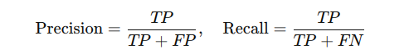
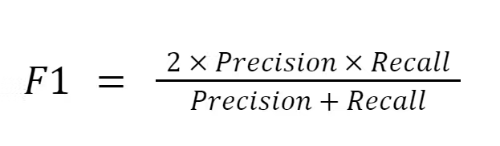
Precision and Recall
Precision measures how well you can find true positives(TP) out of all positive predictions (TP+FP).
Recall measures how well you can find true positives(TP) out of all predictions(TP+FN).

Slide 54
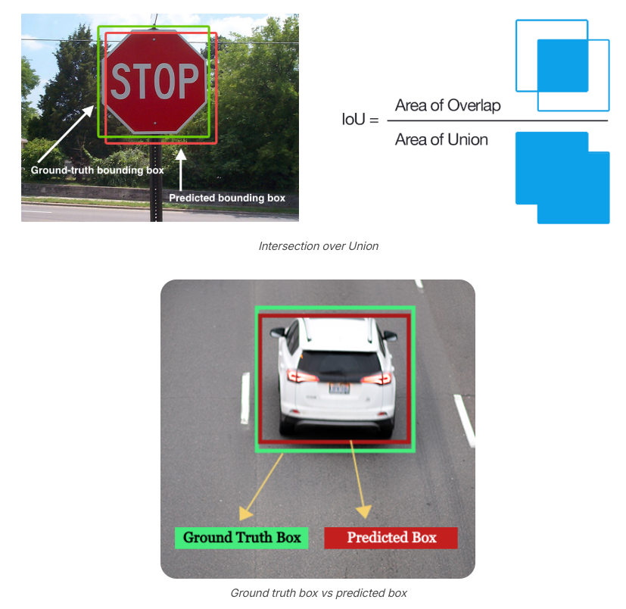
- If IoU > a certain threshold (e.g., 0.5), the prediction is considered a True Positive (TP).
- If IoU ≤ threshold, the prediction is considered a False Positive (FP).

Slide 55
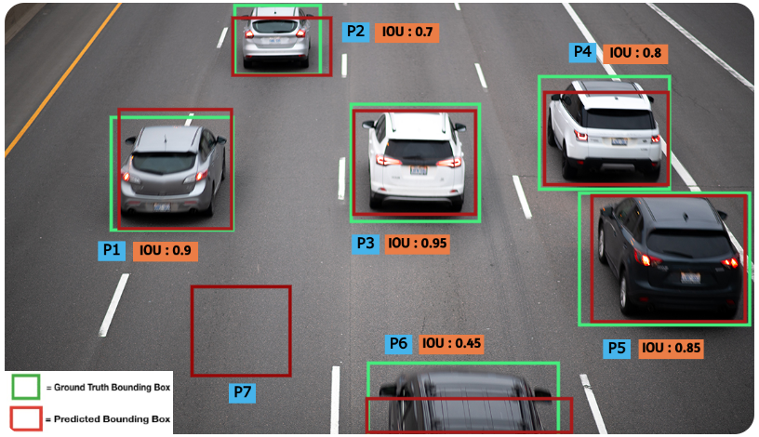
False Positive Cases

Slide 56
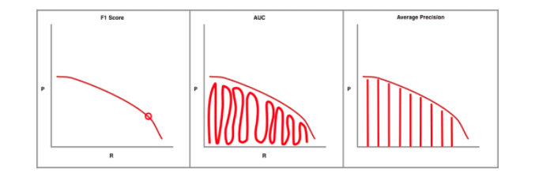
Steps to Calculate mAP for Object Detection
1. For Each Class:
- Compute IoU: For each predicted box, compute its IoU with the ground truth box.
- Assign True Positives and False Positives:
- If IoU > threshold (e.g., 0.5), it’s a True Positive (TP).
- If IoU ≤ threshold or there is no ground truth box for the prediction, it’s a False Positive (FP).
- If there’s a ground truth box with no corresponding prediction, it’s a False Negative (FN).
- Compute Precision and Recall
2. Precision-Recall Score Computation: For each class, plot a Precision-Recall (P-R) curve, which is created by varying the confidence threshold used for accepting predictions (lower threshold = more detections, but possibly more FPs).

Slide 57
Steps to Calculate mAP for Object Detection
3. Average Precision (AP): The area under the Precision-Recall curve is calculated. It is essentially the average of precision values across a range of recall values, typically from 0 to 1. A common method for calculating AP is by integrating over evenly spaced recall points (e.g., 0, 0.1, 0.2, ..., 1). This is called Average Precision (AP) for that specific class.
4. Mean Average Precision (mAP): Once the AP for each class is computed, mAP is simply the mean of the AP values across all object classes.
Mean Average Precision (mAP) is the most widely used metric for evaluating object detection models. It takes into account not just whether objects are correctly detected, but also the localization quality of the bounding boxes. By averaging precision over different recall levels and across all classes, mAP provides a robust measure of detection performance.

Slide 58
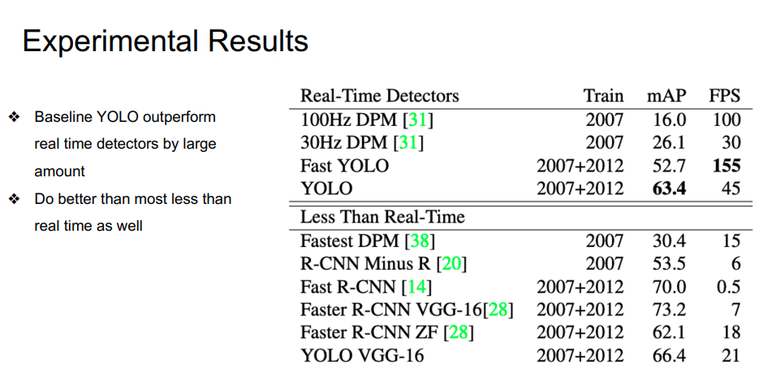

Slide 59


Slide 60


Slide 61
Versions of YOLO
YOLOv2 (2017):
Anchor Boxes:
Introduced the concept of anchor boxes to improve object localization and handle varying aspect ratios.
This allowed the model to predict bounding boxes more efficiently by utilizing predefined shapes.
Dimension Clusters:
Employed k-means clustering to calculate the most optimal set of anchor box sizes specific to the dataset.
This improved precision by ensuring better alignment between anchor boxes and the objects in the dataset.
YOLOv5 (2020, Unofficial):
AutoAnchor:
Introduced automatic anchor box generation, which adapts anchor boxes based on the dataset's distribution without requiring manual intervention.
This further optimized the model's ability to detect objects of different sizes and shapes across various datasets.
Augmentation Strategies:
Incorporated Mosaic and MixUp data augmentation techniques to improve generalization and robustness during training.
These augmentations enhanced model performance, particularly in scenarios with limited or highly varied data.

Slide 62
Summary
Region-based Convnet (R-CNN)
Fast RCNN
Faster RCNN
YOLO

